Slide 1
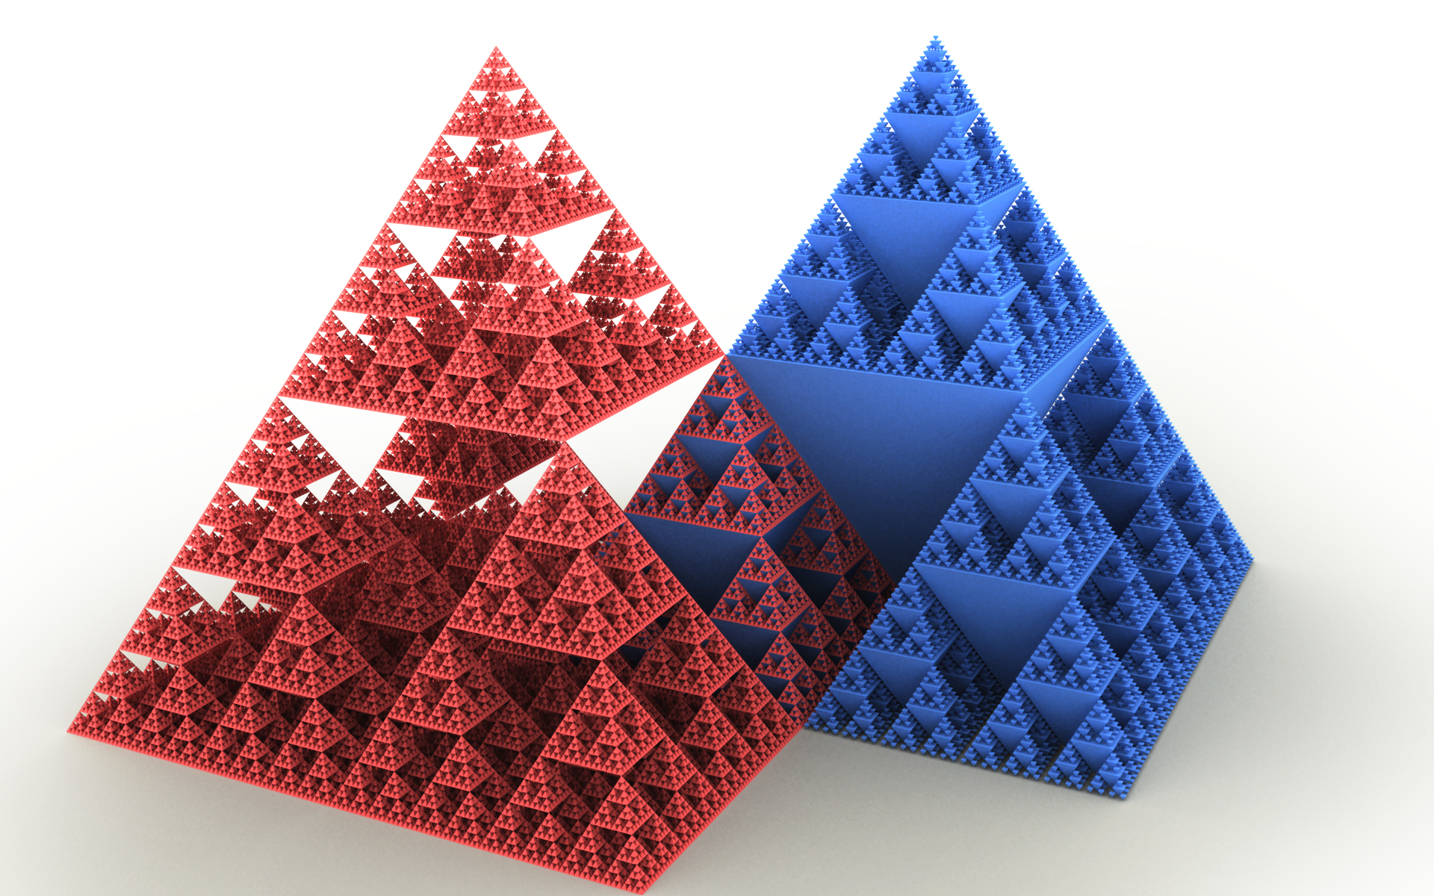
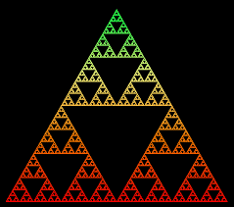
Sierpinski Triangle
Fractal based triangle
Any part resembles the whole
Creates infinite regression in a finite space

Slide 2
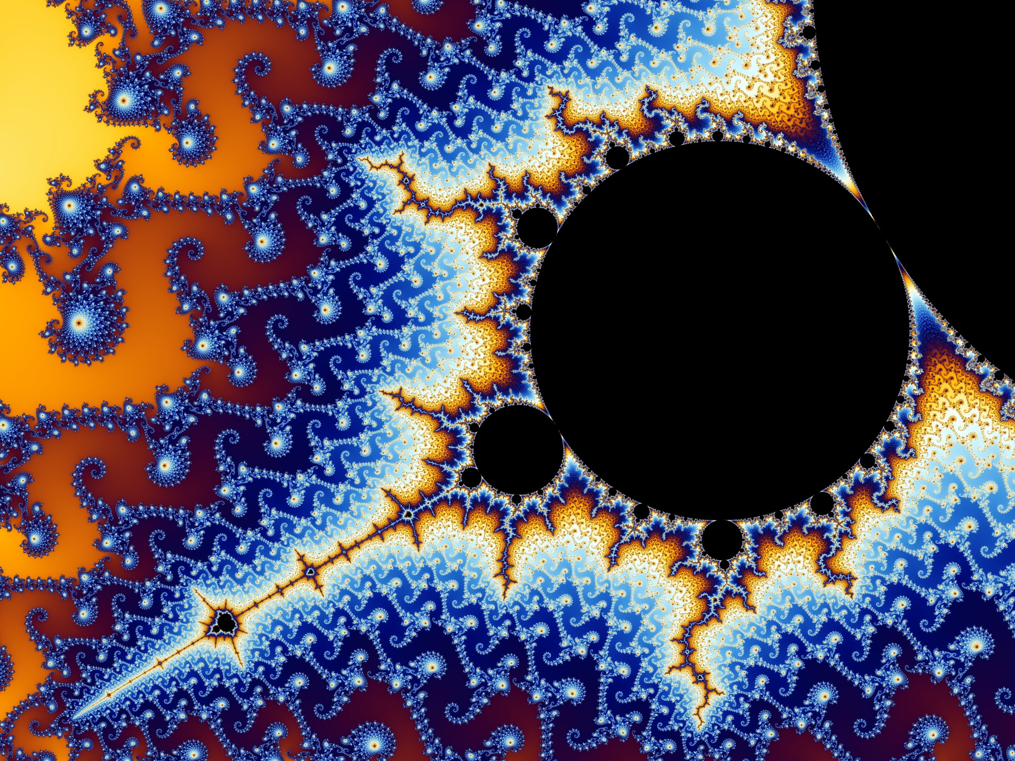
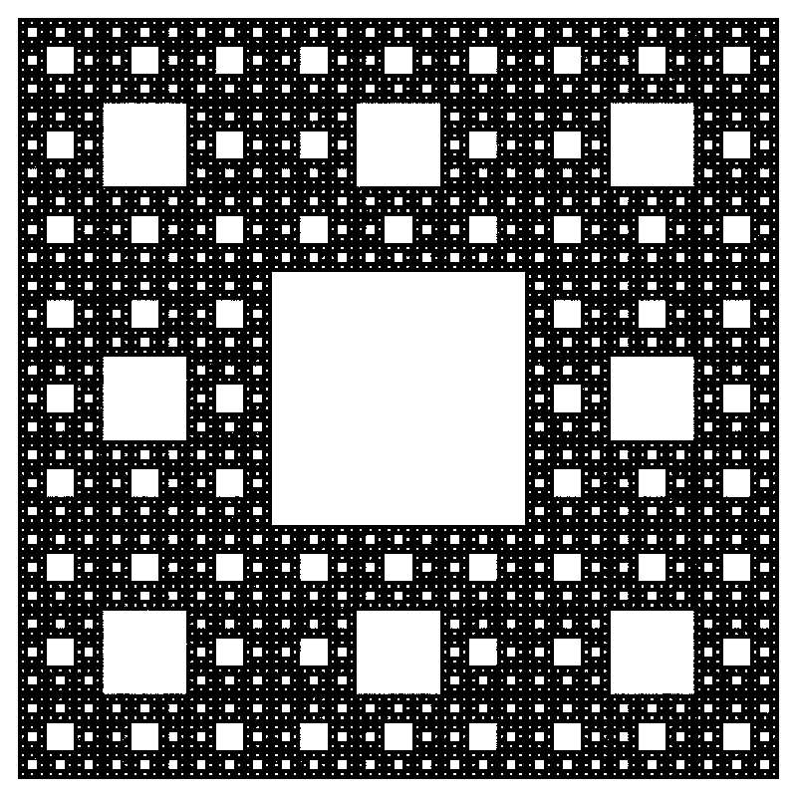
So what exactly is a fractal?
A geometric construction
Self-similar
Look exactly the same viewed at different size

Slide 3
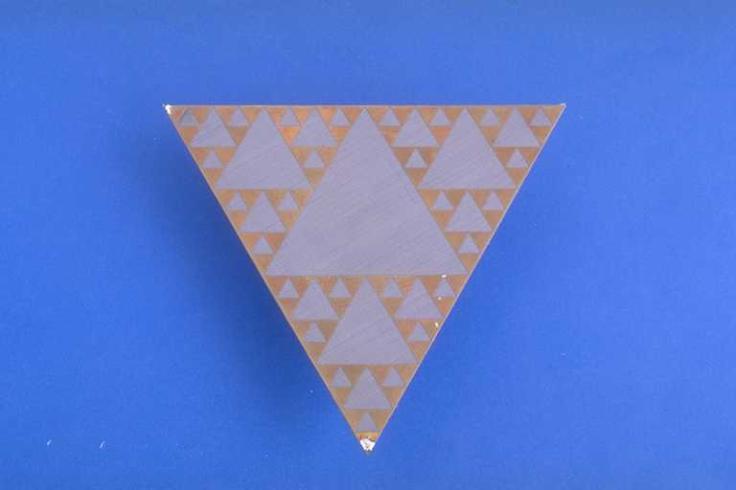
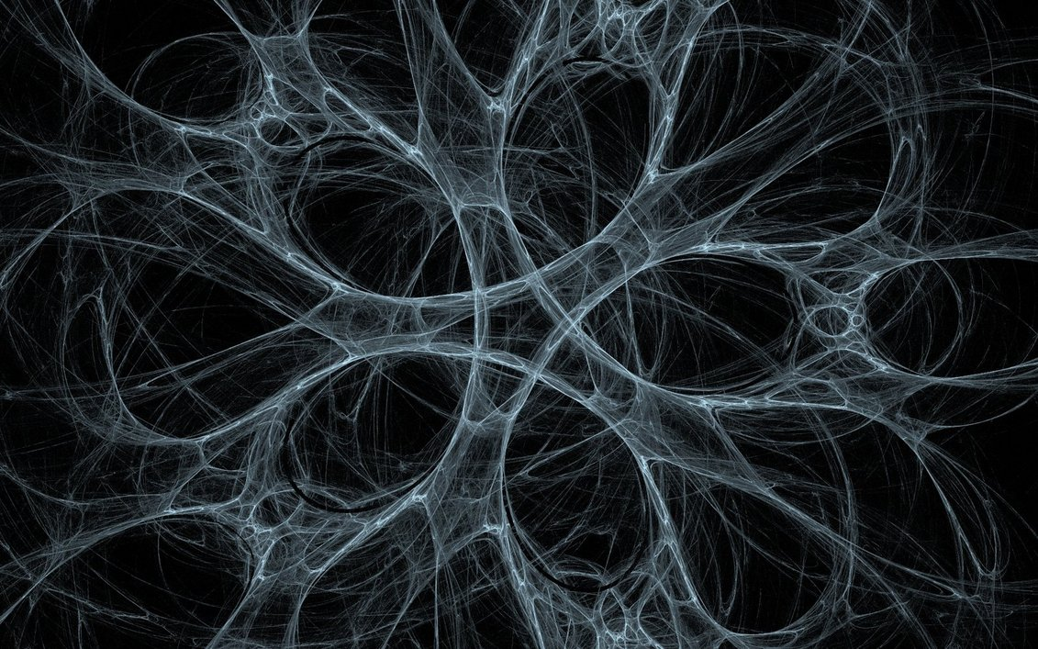
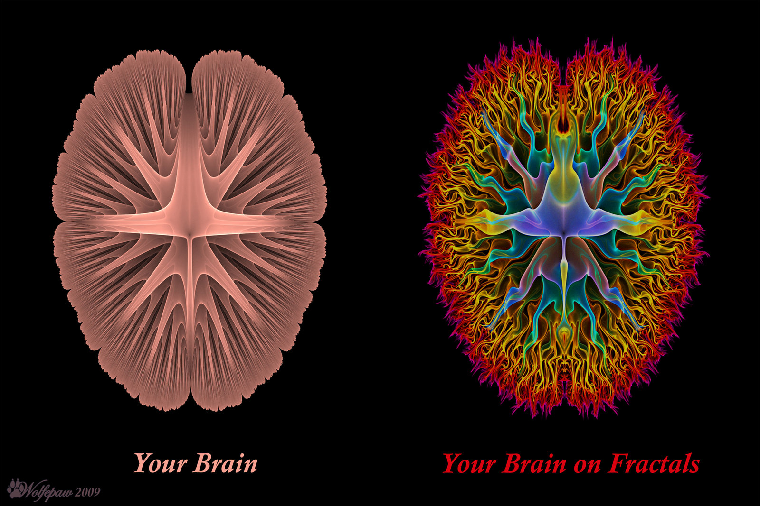
Application of Fractal
Antenna
Network
Neuroscience
Computer Graphics

Slide 4
Fractal Antenna
An antenna uses fractal
Self-similar
Maximize length, perimeter for receive or transmit electromagnetic radiation
Capable of operating with good performance at many different frequencies simultaneously
Smaller in size

Slide 5
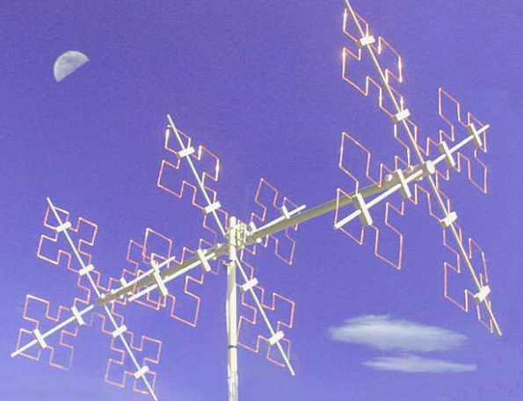
An example of fractal antenna
Shrunken fractal helix

